Slide 1
Sports Info Solutions Football Analytics Challenge
David Schmerfeld
July 2020

Slide 2

Question 1 Most Valuable Defensive Line Position Definition of “Lineman”
Both:
1. Named as Lineman on Roster
- and -
2. Hand on Ground before Snap
Assumption: Linemen always in 3-point stance
True most of the time
Focus analysis on standard/traditional formations

Slide 3
Question 1 Most Valuable Defensive Line Position Definition of Positions
TE
RT
RG
C
LG
LT
TE
9 6
7 5 4 4i
3 2 2i
1 0 1
2i 2 3
4i 4 5 7
6 9
Left
Def-End
LDE
Left
Def-Tackle
LDT
Nose Guard
NG
Right
Def-Tackle
RDT
Right
Def-End
RDE
# of data points:
10,143
9,752
9,001
9,345
10,047
Assumption: No difference b/n 3-4 & 4-3
Simplifies analysis
Difficult to tell base formation from data alone

Slide 4

Question 1 Most Valuable Defensive Line Position Valuation Criteria
Measurable Impact
Indirect Impact
Pass Rushing
Solo/Assisted Sacks
QB Pressures
Tying Up Offensive Linemen
Allow teammate to make play, in lineman’s playing area
2. Ending Plays
Solo/Assisted Tackles
Pass Breakups
3. Turnovers
Fumbles
Interceptions

Slide 5
Question 1 Most Valuable Defensive Line Position Pass Rushing
Key Points:
DEs are best pass rushers
NGs good at assisting sacks,
but they are assisting DEs

Slide 6
Question 1 Most Valuable Defensive Line Position Ending Plays
Key Points:
NGs make the most tackles
DTs break-up the most passes

Slide 7
Question 1 Most Valuable Defensive Line Position Turnovers
Key Points:
DEs force the most fumbles
Recovering fumbles appears random
INTs are minimal

Slide 8
Question 1 Most Valuable Defensive Line Position EPA+ Values
Play | Average EPA+ D-Line plays only
Interception | 5.3
Recovered Fumble | 5.0
Forced Fumble | 4.2
Solo Sack | 1.7
Assisted Sack | 1.7
Pass Breakup (No INT) | 1.1
Pressure (No Sack) | 1.0
Solo Tackle | 0.6
Assisted Tackle | 0.5
Assumptions using EPA+ (positive play results only) instead of EPA (all plays)
Negative aspects of play (exs., big gain by offense after QB pressure or before tackle) are not fault of the lineman making the play
Good players (who make a lot of good plays) also don’t make a lot of bad plays to cancel out the good plays

Slide 9
Question 1 Most Valuable Defensive Line Position Measurable Value
Measurable Impact
Pass Rushing
Solo Sacks
Assisted Sacks
QB Pressures
Pt. values
1.7
0.8
1.0
2. Ending Plays
Solo Tackles
Assisted Tackles
Pass Breakups
0.6
0.2
1.1
3. Turnovers
Recv’d Fumbles
Forced Fumbles
Interceptions
5.0
4.2
5.3
Key Points:
DEs make the most measurable impact
But there’s more to the story…
Assumption: Assisted sacks/tackles worth ½ of play value
Player w/ assist only partially responsible for the sack/tackle

Slide 10
Question 1 Most Valuable Defensive Line Position Indirect Impact
Indirect Impact
Methodology
Tying Up Offensive Linemen
Allow teammate to make play, in lineman’s playing area
Run play designed to go toward lineman’s lineman’s playing “zone”
- but -
2. The lineman didn’t record a measurable statistic (tackle, etc.)
Assumptions in not including passing plays
Passing plays are more often farther away from a lineman’s playing zone
Ability to tie up offensive blockers should be same whether run or pass

Slide 11
Question 1 Most Valuable Defensive Line Position Indirect Impact - Zones
Runs to A Gap
Zones of NG & DT
A
C
G
T
TE
1 0 1
2i 2 3
4i 4 5 7
6 9
Nose Guard
NG
Def-Tackle
DT
Def-End
DE

Slide 12
Question 1 Most Valuable Defensive Line Position Indirect Impact - Zones
Runs to B Gap
Zones of
DT & DE (in 4i, 4, 5, or 7)
B
C
G
T
TE
1 0 1
2i 2 3
4i 4 5 7
6 9
Nose Guard
NG
Def-Tackle
DT
Def-End
DE

Slide 13
Question 1 Most Valuable Defensive Line Position Indirect Impact - Zones
Runs to C Gap
Zone of DE
C
C
G
T
TE
1 0 1
2i 2 3
4i 4 5 7
6 9
Nose Guard
NG
Def-Tackle
DT
Def-End
DE

Slide 14
Question 1 Most Valuable Defensive Line Position Indirect Impact - Zones
Runs to D Gap
Zone of DE (in 6 or 9)
D
C
G
T
TE
1 0 1
2i 2 3
4i 4 5 7
6 9
Nose Guard
NG
Def-Tackle
DT
Def-End
DE

Slide 15
Question 1 Most Valuable Defensive Line Position Indirect Impact - Stats
x
multiply
Assumption using EPA (all plays) instead of EPA+ (positive play results only)
Negative performance (inability to tie up blockers allowing runner to get larger
gain) is relevant
Assumption: Same # of players providing support behind each lineman
Not true, so keep in mind that indirect impact is biased against DEs
Still useful to measure players w/in each position type

Slide 16
Question 1 Most Valuable Defensive Line Position Indirect Impact - Results
Key Points:
NGs have a large indirect-impact advantage (allowing other teammates make plays)
Assumption: All of the linemen’s teammates have same ability
Less of a problem when averaging out values over all teams or when there is a lot of data in which one player had many different teammates

Slide 17
Question 1 Most Valuable Defensive Line Position Overall Value
Key Points:
DEs are most valuable overall
NG’s large indirect impact make them 2nd-most valuable
No difference b/n left & right sides

Slide 18
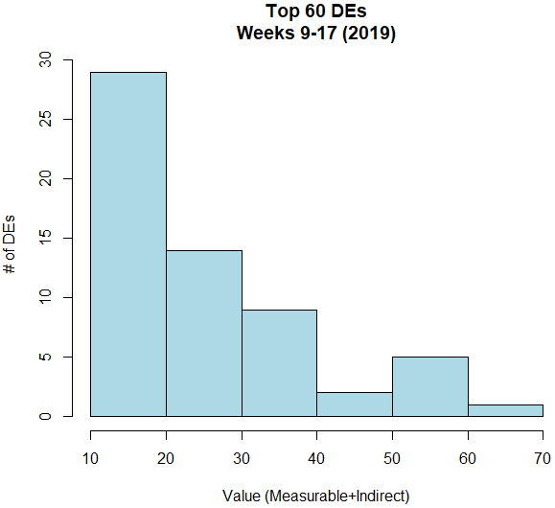






Question 2 Distribution of Talent Defensive Ends
RDE
RDE
RDE
LDE
RDE
Key Points:
20 EPA was average value for starting DEs; elite value was >50 EPA
Bosa’s negative indirect impact value drops him from #2 to #5
Quinn’s & Houston’s indirect impact values move them into top 5

Slide 19
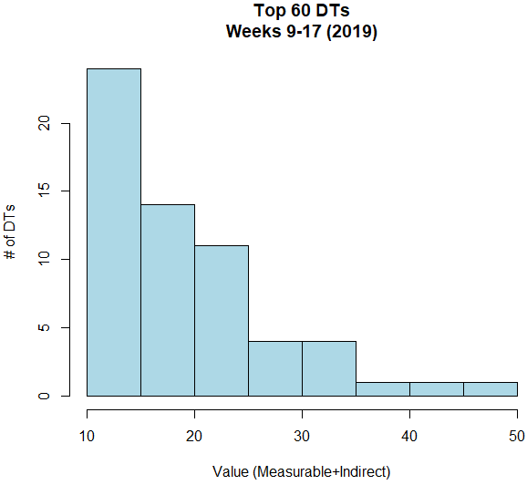




Question 2 Distribution of Talent Defensive Tackles
RDT
RDT
LDT
RDT
RDT
Key Points:
15 EPA was average value for starting DTs; elite value was >30 EPA
Donald’s large indirect impact value made him the most valuable DT
→ Drawing double teams helps a lot w/ indirect impact value!

Slide 20
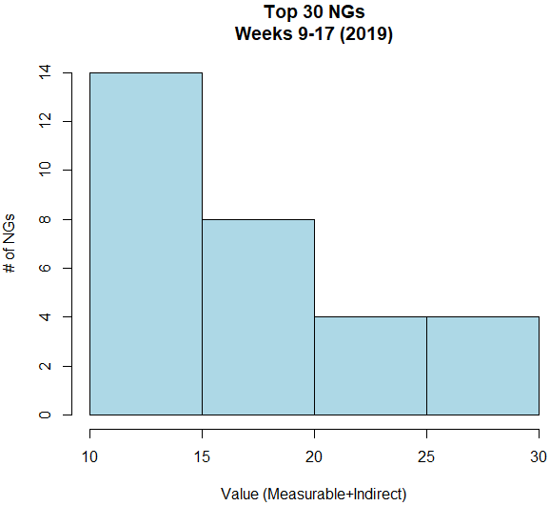


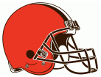

Question 2 Distribution of Talent Nose Guards
Key Points:
15 EPA was average value for NGs; elite value was >25 EPA
NG value more evenly distributed than other defensive line positions
Best NGs all contribute significant indirect impact value

Slide 21
Question 3 Game Scenarios Passing vs. Running
Measurable Impact
Indirect Impact
DEs
Most Valuable
Pass Rushing
Solo/Assisted Sacks
QB Pressures
Tying Up Offensive Linemen
Allow teammate to make play, in lineman’s playing area
NGs
Most Valuable
2. Ending Plays
Solo/Assisted Tackles
Pass Breakups
Are DEs more valuable in passing situations?
Are NGs more valuable in running situations?
3. Turnovers
Fumbles
Interceptions

Slide 22
Question 3 Game Scenarios Score Difference
Offense Behind
Offense Ahead
Offense Behind
Offense Ahead
Offense Behind
Offense Ahead
Key Points:
NG value has steep, upward slope—changes most based on score difference
DE value has slight downward slope—least valuable when Offense ahead a lot
DT value steady across all score differences

Slide 23
Question 3 Game Scenarios Score Difference
Offense Behind
Offense Ahead
Key Points:
NGs most valuable when offense ahead (running situations)
DEs most valuable when offense behind (passing situations)
DEs become least valuable when offense ahead by 14+ points

Slide 24
Question 3 Game Scenarios Yards-to-Go
Key Points:
All 3 positions get more valuable as yards-to-go to 1st down gets shorter
NG value increases the most at short distances to go for 1st down

Slide 25
Question 3 Game Scenarios Yards-to-Go
Key Points:
NGs most valuable when yards-to-go to 1st down is less than 6½ yards
NGs least valuable when yards-to-go to 1st down is more than 20½ yards

Slide 26
Recap
1. DEs overall most valuable
→ NGs 2nd most valuable
w/most indirect impact value
2. NG value more evenly-
distributed than DEs & DTs
→ Indirect impact value
can make a difference
(ex., Aaron Donald’s
#1 ranking includes
⅓ indirect impact value)
3. NGs most valuable when:
Offense is ahead
Yards-to-go to 1st down is
<6½ yards
DEs
DTs
NGs
Offense Behind
Offense Ahead

Slide 27
Limitations/Future Analysis
Obtain data to identify defense alignment—3-4 or 4-3
Define positions as: 3-4 NG, 3-4 DE, 4-3 DT, 4-3 DE
Indirect impact value based on running plays only
With/Without-You statistic possible alternative for linemen who
played w/ a lot of different teammates
Individual player values not rate-based
Larger sample sizes needed for reliable individual rate-based values
Individual players identified most valuable for weeks 9–17 (2019)
Not necessarily best players overall

